Slide 1

Data Glacier Internship Lisum 16
G2M Cab Investment Case Study
By Shreya Ramachandra
Date: 19/12/2022

Slide 2
Problem Statement
US-based private company is considering investing in taxi services with two business proposals and has chosen Go-to-Market(G2M) approach
Objective: The data sets each represent various facets of the client profile. The analysis is performed in helping the company to choose the best taxi service based on business insights
Analysis is performed based on the following steps:
Ensuring accurate, reliable, and valid data by checking for null values, duplicates, and incorrect data formats
Checking for the number of users based on demographics, age, time, and gender
Comparing the transactions and profits of both the company to determine the popular taxi service
Investment recommendations

Slide 3
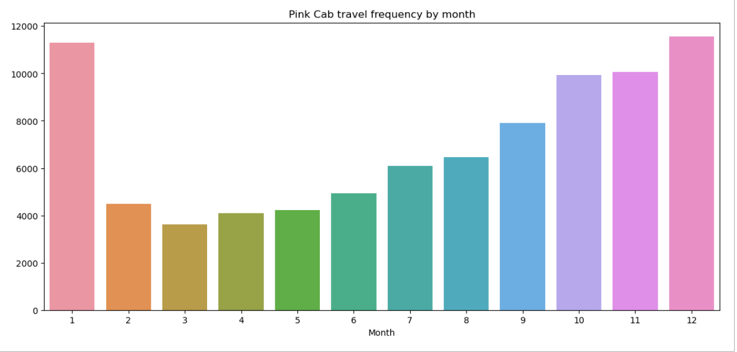
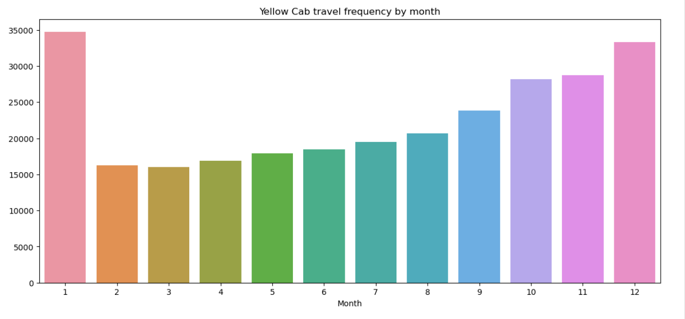
Number of Transactions
The above bar graph depicts that the number of transactions is more from October to January (Winter Season) for both the companies when compared to the rest of the year
The highest number of transactions for pink cabs is around 11,000 whereas for yellow cabs is around 35,000

Slide 4

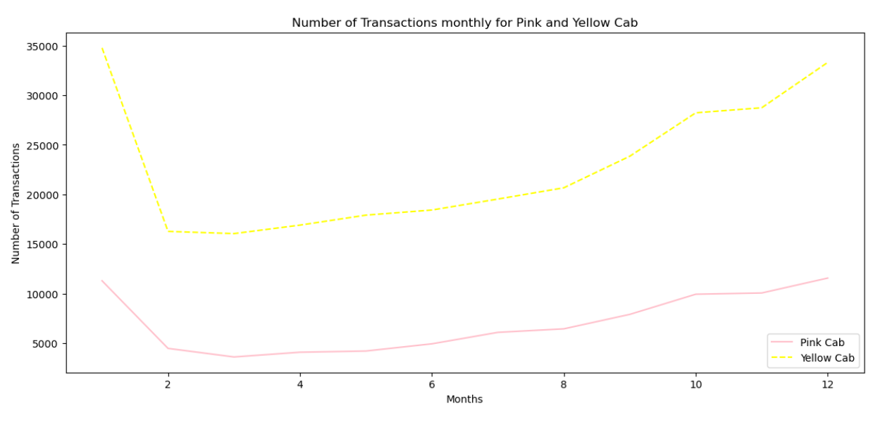
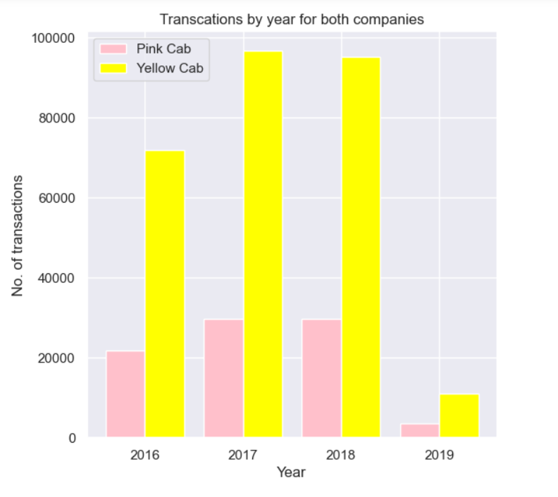
Comparing Pink and Yellow Cab Company
From the graph, yellow cab is 3 times better than pink cab

Slide 5

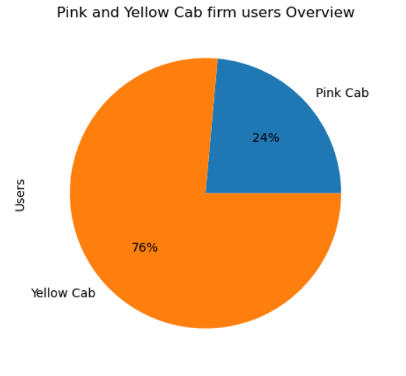
Pink and Yellow Cab users overview
76% of the users rely on yellow cab service

Slide 6
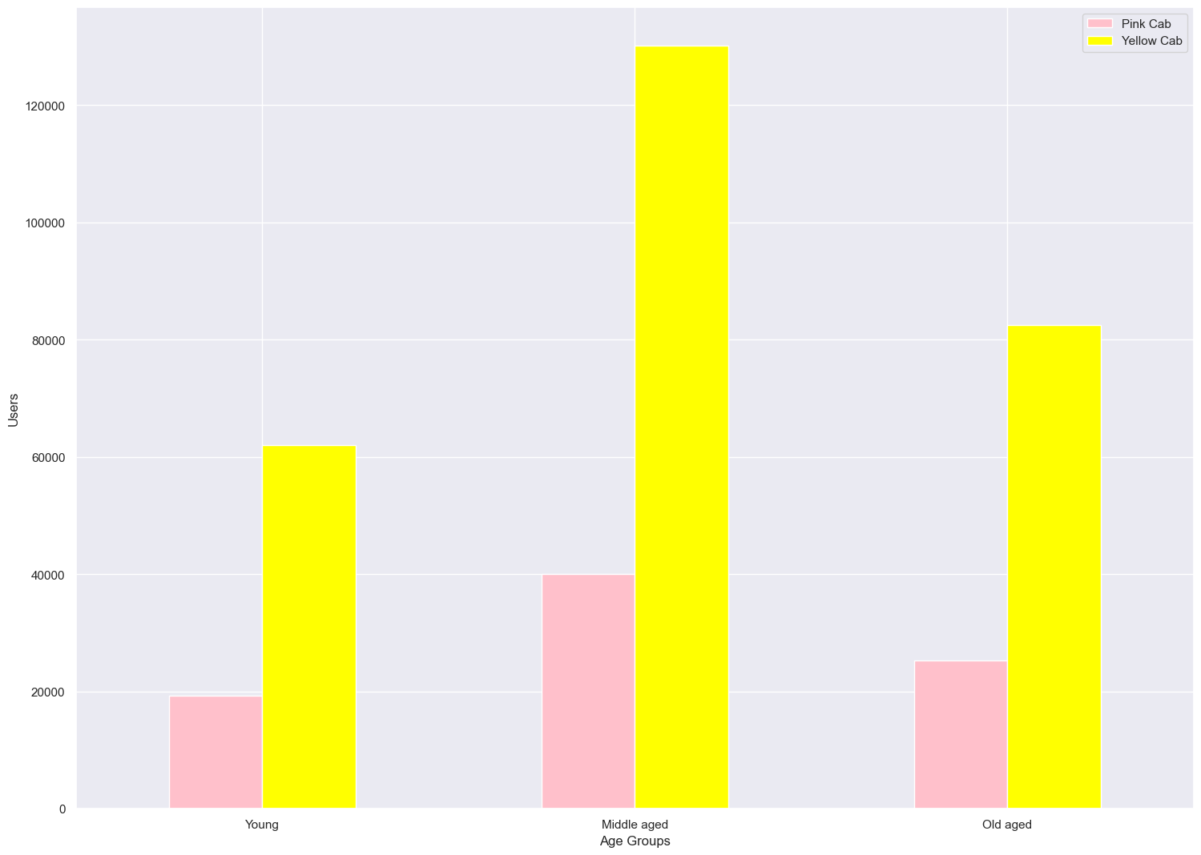
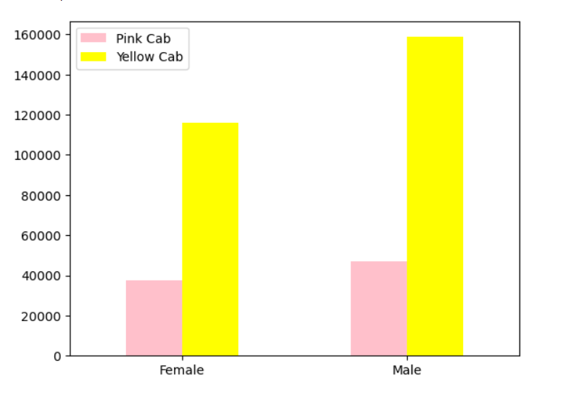
Middle aged groups people are more likely to book a cab Number of male users are approximately 15% and yellow cab is most preferred by all the age groups more than female in both the companies
Classification of users based on age group and gender

Slide 7
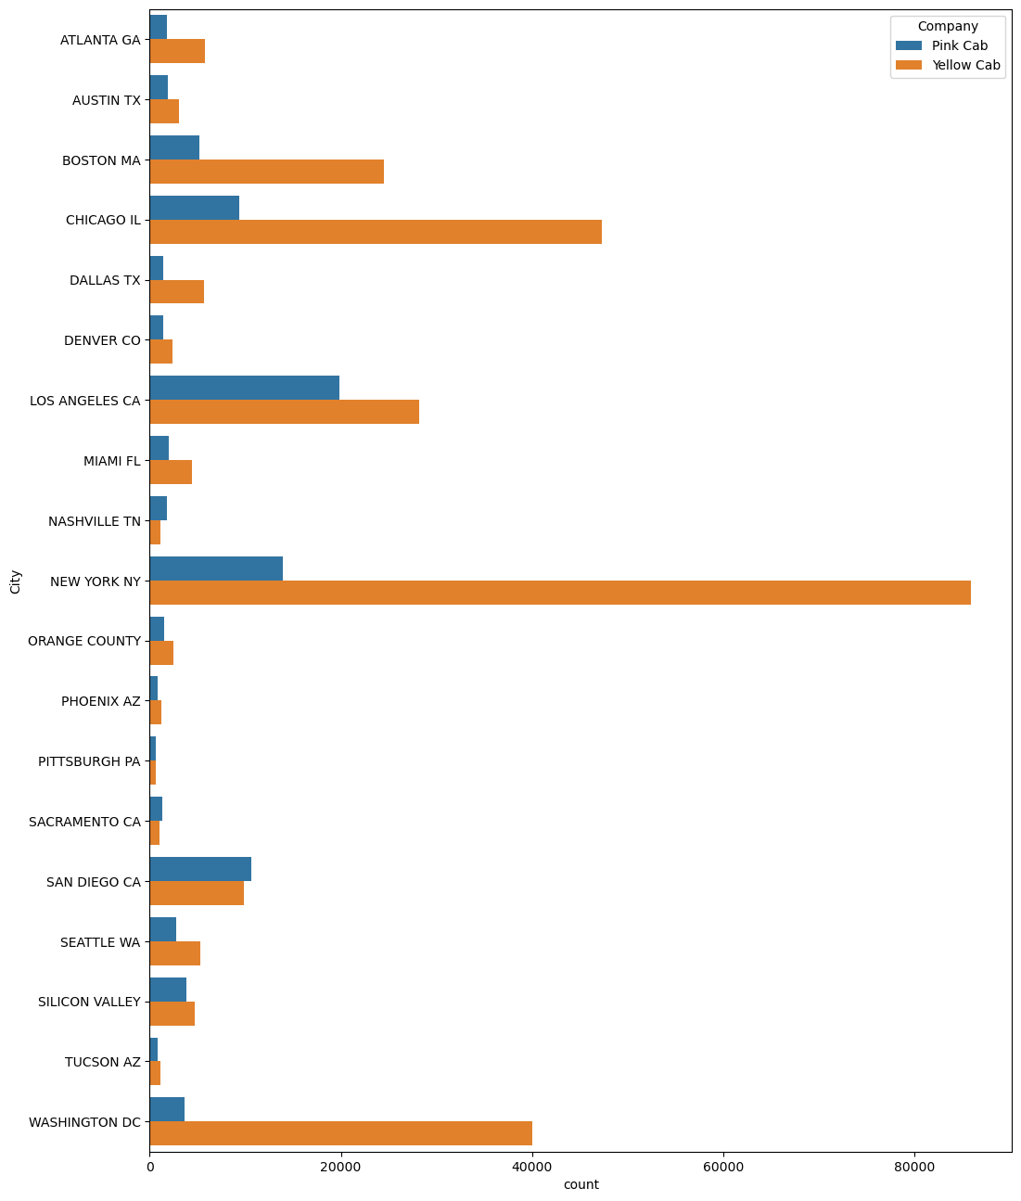
Total number of users based on demographics
Users in metropolitan city such as New York, Chicago, Boston, Los Angeles and Washington are greater in number compared to other cities and yellow cab is more preferred by the users

Slide 8
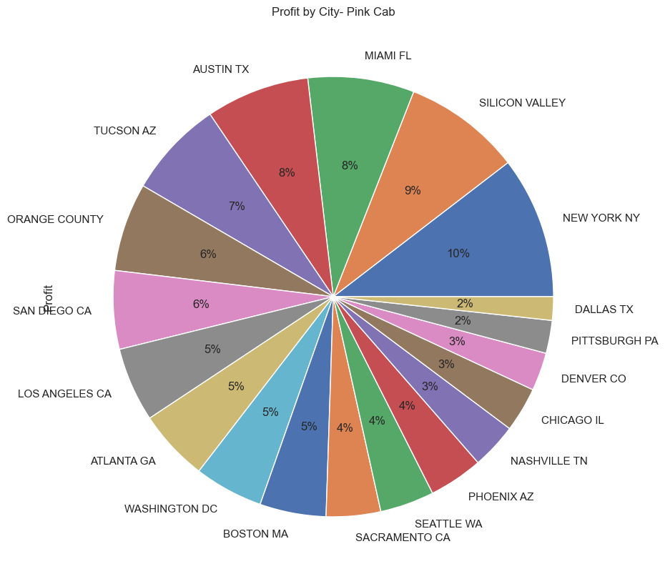
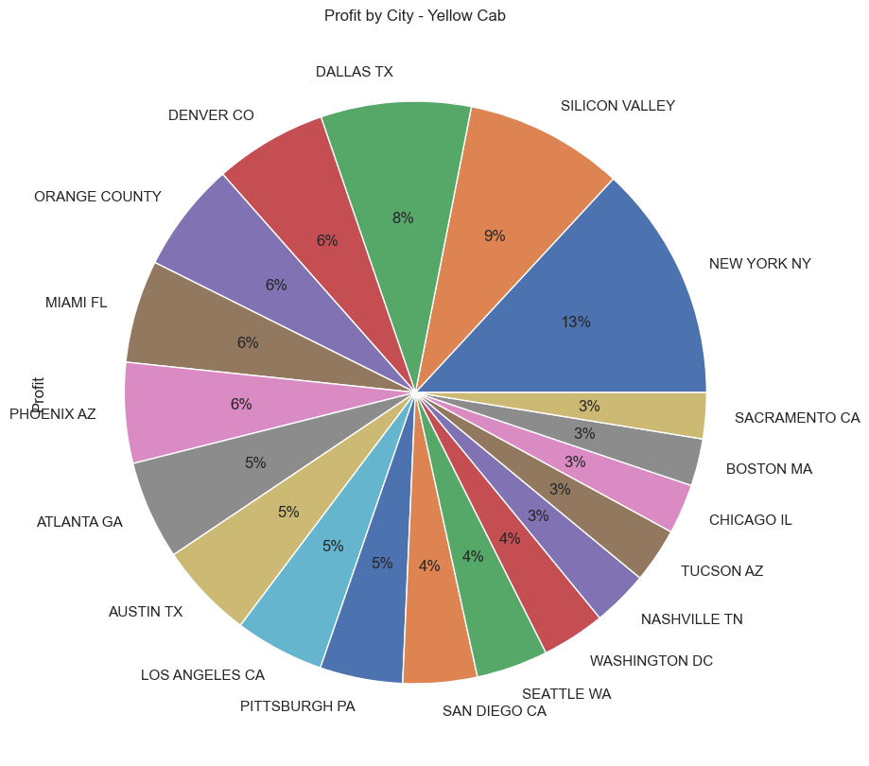

Profit Analysis by cities
New York and Silicon Valley has more profits in both the cab companies

Slide 9
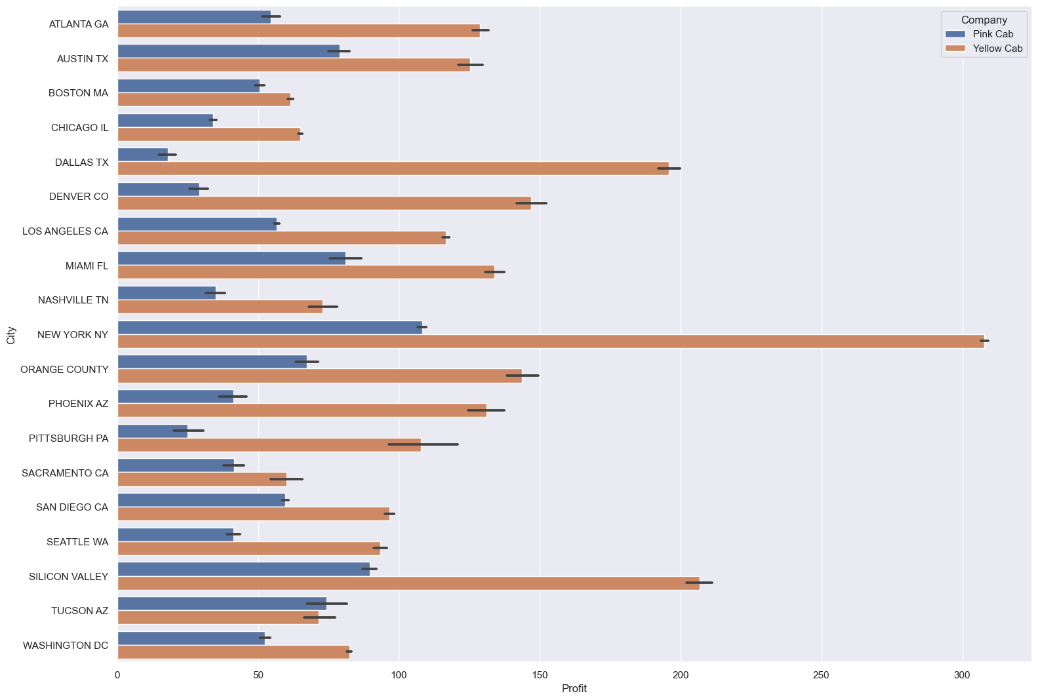
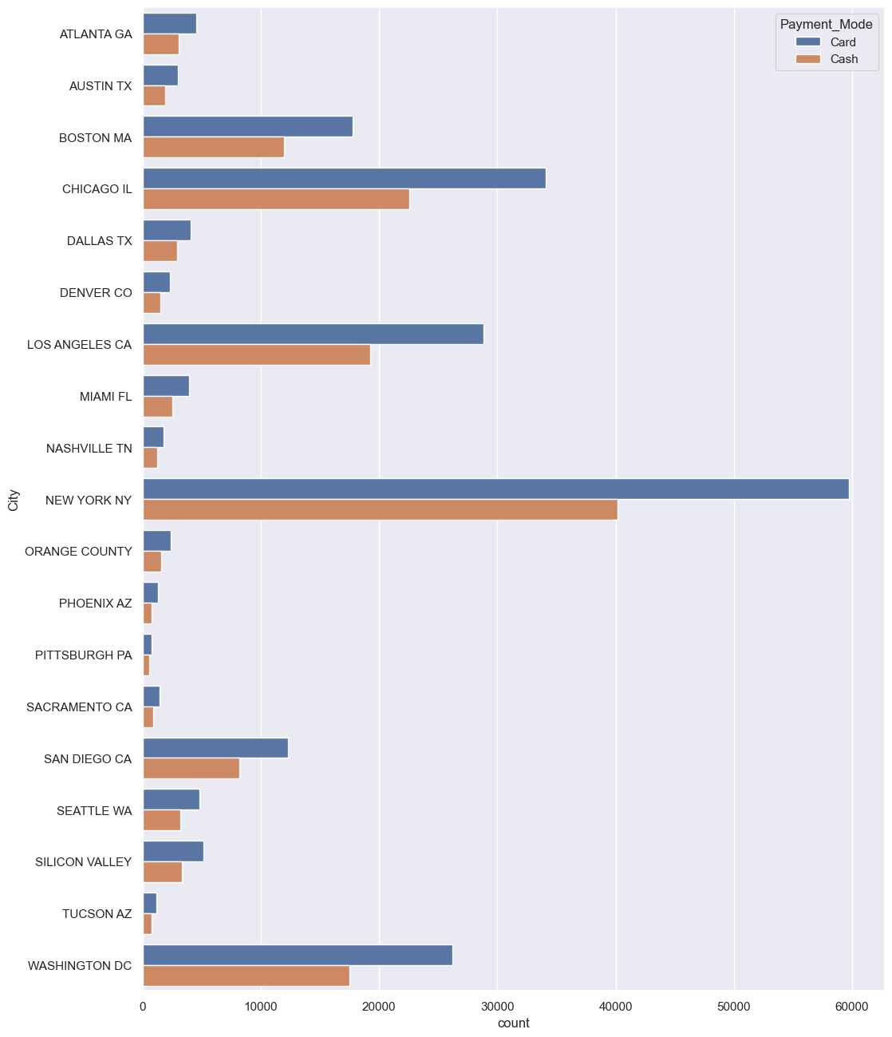
Profits and Payment methods
Profit for pink cab in New York has the highest amount of about $100 whereas for yellow cab is more than $300. Least profit is at Dallas for pink cab whereas for yellow cab is at Tucson and Sacramento
Card payment is most used by the users compared to cash payment in most of the city

Slide 10
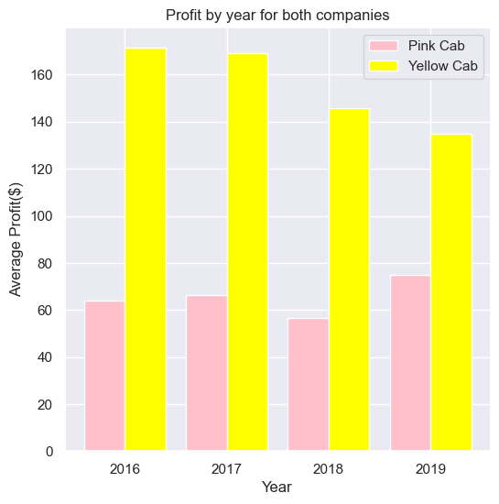
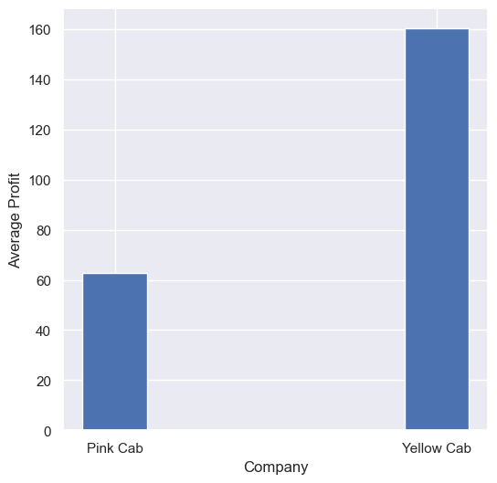
Average Profits
Average profit of the yellow cab company is 2.5 times more than the pink cab company

Slide 11
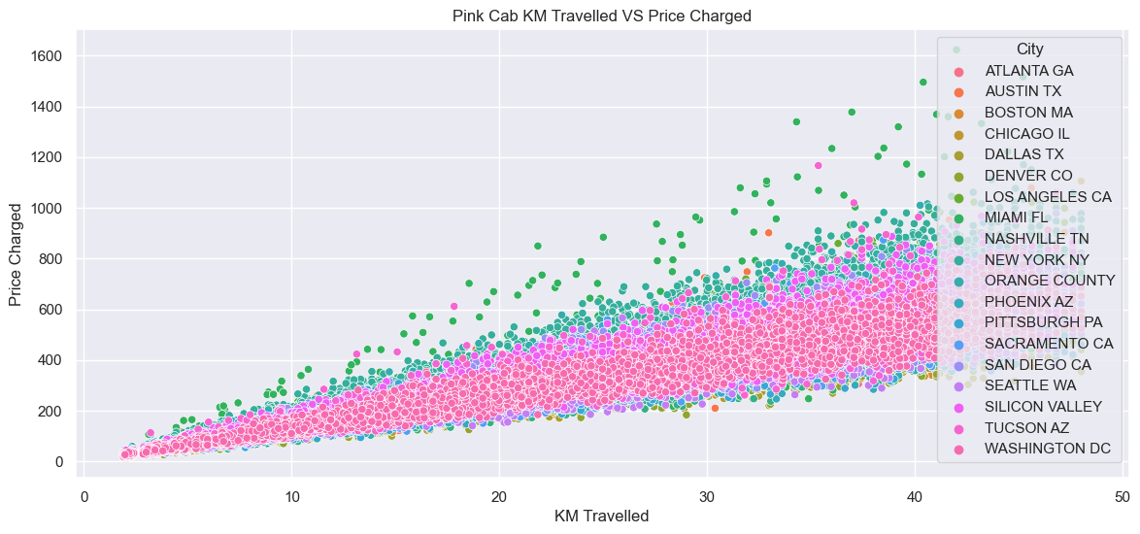
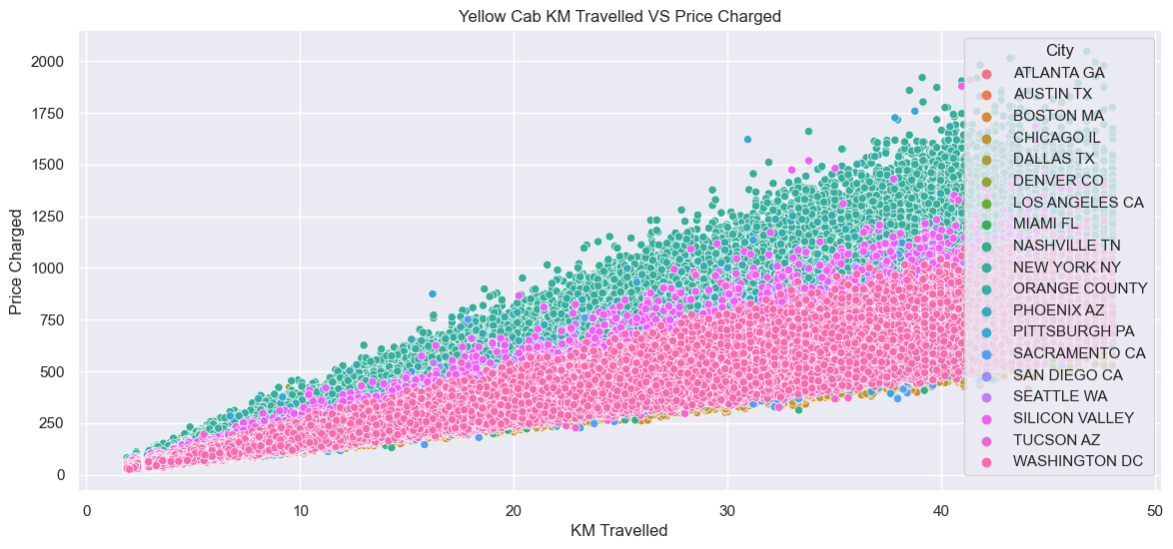
Comparing KM travelled over price charged
Prices are higher in metropolitan area. Yellow cab charges more even in Suburb than pink cab.

Slide 12

Investment Recommendations
From the evaluation based on the following analysis, Yellow Cab Company is better for investment than Pink Cab Company
Number of transactions: Transactions for the yellow cab company are 3 times better than the pink cab company
Population based analysis: 76% of the cab users rely on the yellow cab company
Gender based analysis: Male users are 15% more in population than female users
Age group: Cab services are used majorly by middle-aged users compared to other age grouped people
Payment mode: Card payment is most preferred by the users
City wise profit analysis: Cab services are expensive in metropolitan areas compared to suburbs
KM traveled: Number of KM traveled by yellow cab is more which is directly proportional to the price charged
Average profit: Yellow cab company has 2.5 times more profit than the pink cab company
Conclusion: After analyzing the data, Yellow cab company is recommended to US private company for investment

